Slide 1

A Social Media Analysis Case Study
Scraping and Analyzing Subreddits related to Disney

Slide 2
Background
“forms of electronic communication (such as websites for social networking and microblogging) through which users create online communities to share information, ideas, personal messages, and other content (such as videos)”. - Merriam-Webster
Examples
Facebook
Twitter
LinkIn
Reddit
YouTube

Slide 3
Reddit
Created in 2005
Broken down into subReddits
Managed by an administrator
Posts on subreddits can be commented on by followers of subreddit
SubReddits used for this study
r/DisneyWorld – over 36,000 followers
r/disney – over 613,000 followers

Slide 4

How can a Social Media Analysis be beneficial to a business?

Slide 5
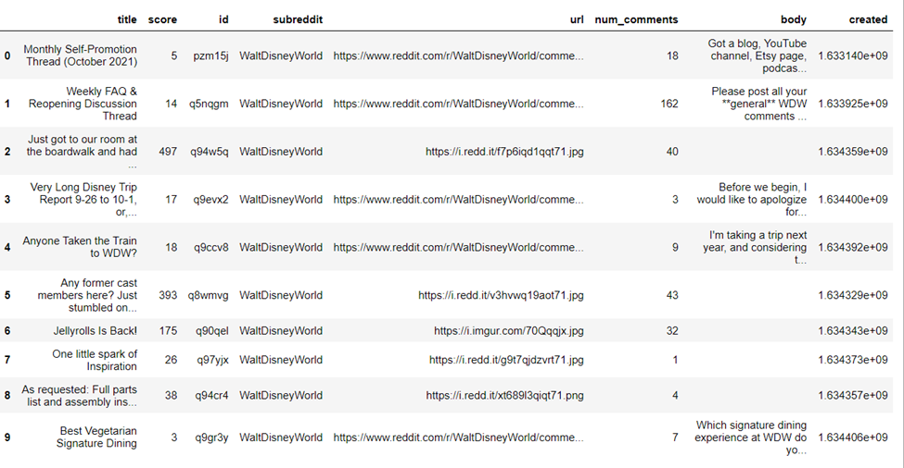
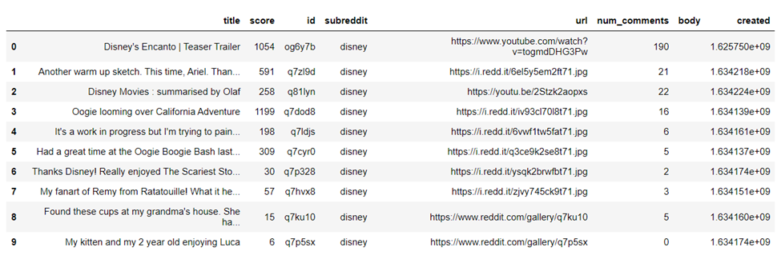
Methods
Web scrapping
Python
PRAW package

Slide 6


Methods
Sentiment Analysis
Cleaning
Tokenizing
Stop Words
Normalization
VADER

Slide 7
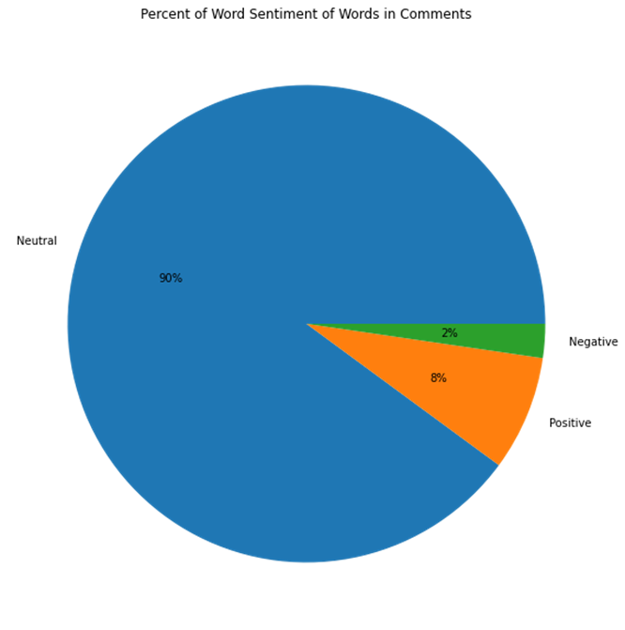
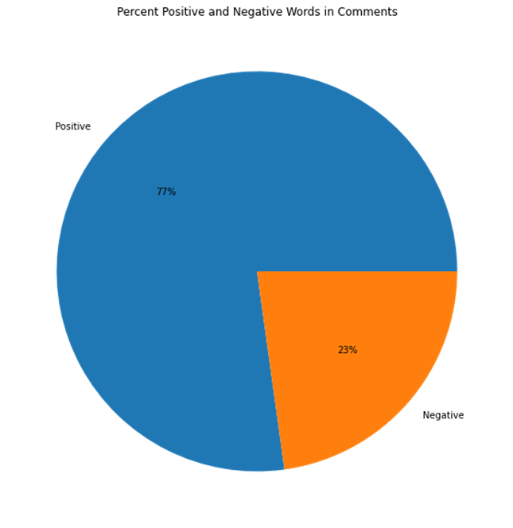
FAQs

Slide 8
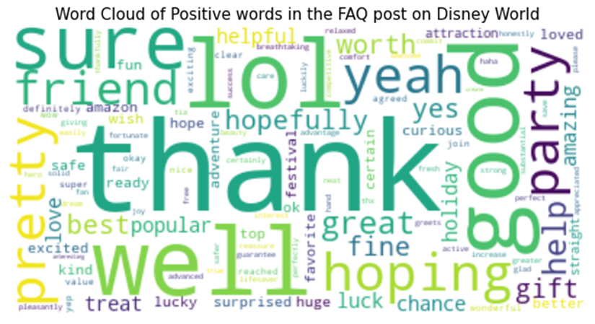
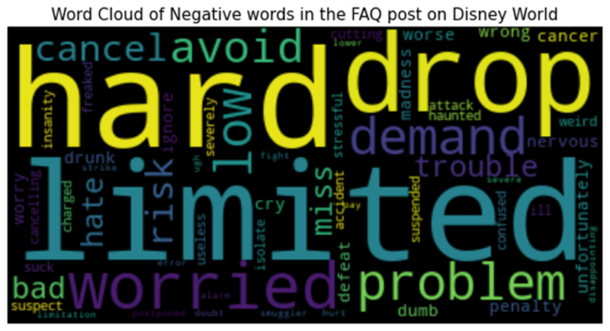
FAQs

Slide 9
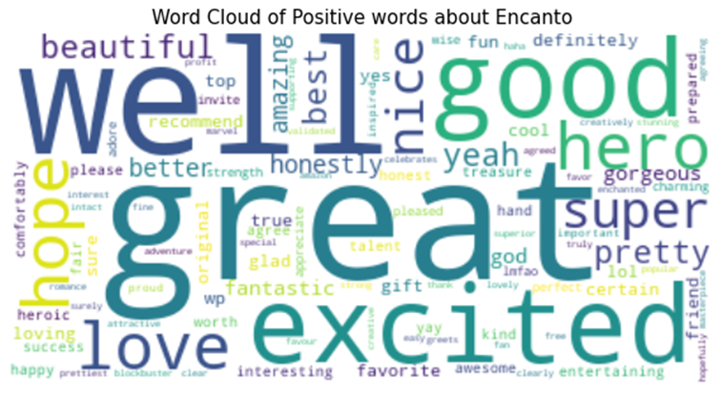
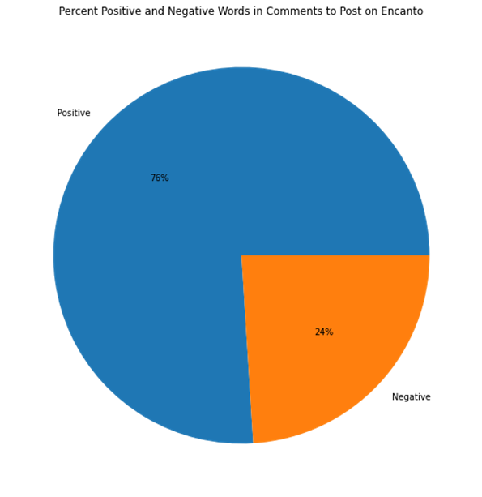
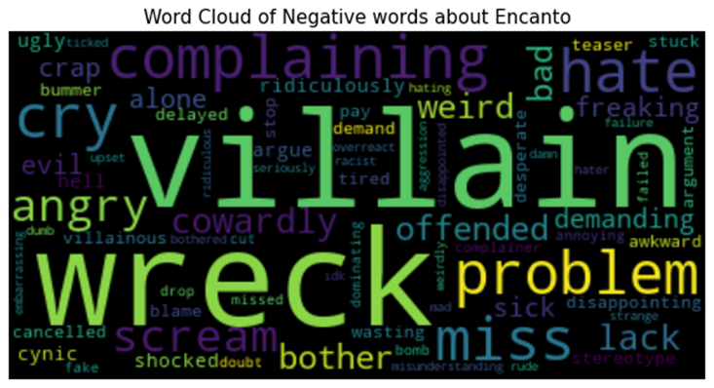
Encanto

Slide 10
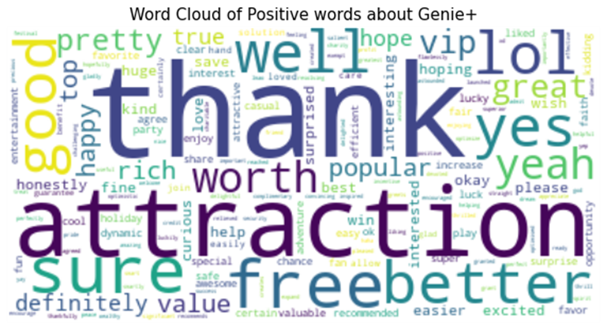
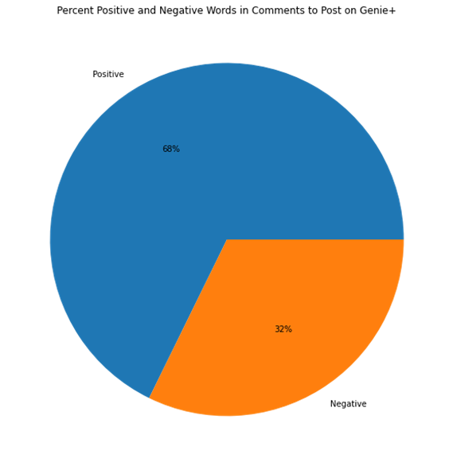
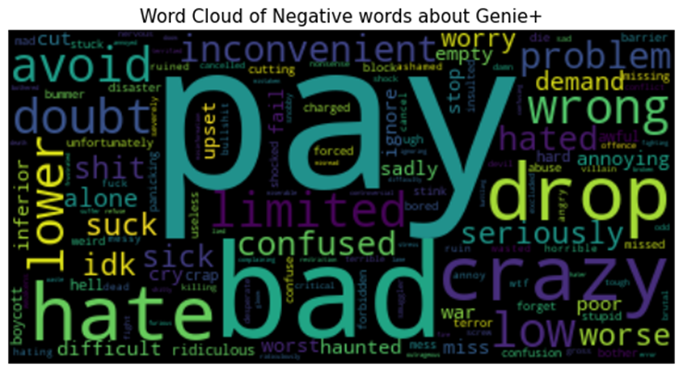
Genie+

Slide 11
Conclusion
A social media presence is an essential tool for a business
A social media analysis can provide instant and constant updates on the public’s reception of a product and perception of a business.

